Slide 1
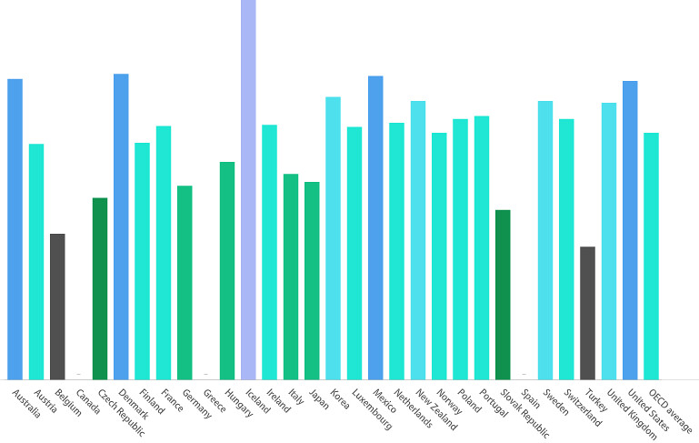
The Great Resignation Analysis
Contributing Members:
Gus Sanchez
Marc Palumbo
Roxann Lopez
Heather Bailey
Notes:
Heather - Welcome to The Great Resignation Analysis! Im Heather Bailey, and our group members are Gus, Marc and Roxann.

Slide 2



Topic Selection
Notes:
Heather - What is the Great Resignation? An ongoing economic trend in which employees have voluntarily resigned from their jobs en masse, beginning in early 2021 in the wake of the COVID-19 pandemic. For our project, we will be focusing on the U.S. workforce, primarily in the manufacturing, healthcare and hospitality, and education sectors.

Slide 3

Background
A little over a year after the COVID-19 pandemic began, economists and other observers took note of a rising job quit rate, as measured by the U.S. Bureau of Labor Statistics (BLS) Job Openings and Labor Turnover Survey (JOLTS) program. JOLTS recorded a seasonally adjusted quit rate of 2.4 percent in the second month of the program’s existence (January 2001), and although this level was matched at other times, it was not surpassed until March 2021, when the quit rate reached 2.5 percent. This new record was quickly eclipsed in April 2021, when the quit rate stood at 2.8 percent; the current record is 3.0 percent, first reached in November 2021 and matched in December 2021. The rise in the quit rate has been called the “Great Resignation”, with many articles in the popular press speculating about why individuals have become more willing to leave their current employers. The fact that the labor force participation rate remains below its pre-pandemic high suggests that some of those who quit their jobs found new jobs and others exited the labor force.
Notes:
Heather -

Slide 4

Motivation
We chose this topic as a group because it has affected everyone in the country in one way or another. COVID-19 changed the world, and certain things will never be the same. Employment rates plummeted, unemployment claims went through the roof, and in turn our economy has suffered a significant negative impact, and will likely continue to suffer for years to come. Understanding the contributing factors to the Great Resignation will enable us to understand our country and our people as a whole, and better predict future economic trends.

Slide 5




Data Sources
U.S. Bureau of Labor Statistics
All Employees- Manufacturing | FRED
BEA- Bureau of Economic Analysis Table 1 - Gus Machine Learning
BEA- Bureau of Economic Analysis Table 2-Gus Tableau
Kaggle - https://www.kaggle.com/datasets/pavansubhasht/ibm-hr-analytics-attrition-dataset

Slide 6
Questions we hope to answer:
What are the contributing factors to individuals resigning from their jobs?
Is there a correlation between age (retirement, etc.), job satisfaction, rate of pay, and resignation?
What will future U.S. economic trends look like?
What industries will be most impacted in the future by resignations?

Slide 7
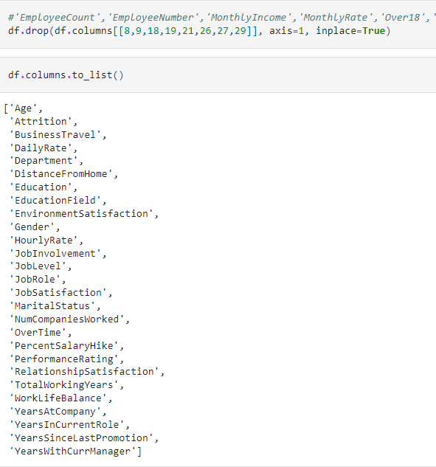
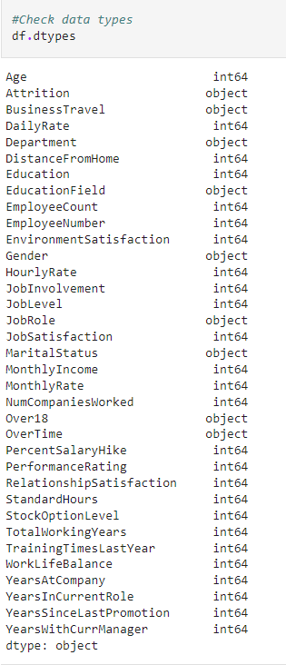
Data Cleaning / ETL
Employee Attrition
The Five R’s
Retirement
Relocation
Reconsideration
Reshuffling
Reluctance
Notes:
Roxann - Employee attrition measures how many workers are voluntarily or involuntarily leaving their jobs for man reasons. During the COVID-19 pandemic, there was a mass exit in the workforce that is widely known as the Great Resignation. There are various contributing factors, but they can be broken down into five categories known as The Five R’s. Retirement, relocation, reconsideration, reshuffling, reluctance. Talk about process of cleaning data

Slide 8
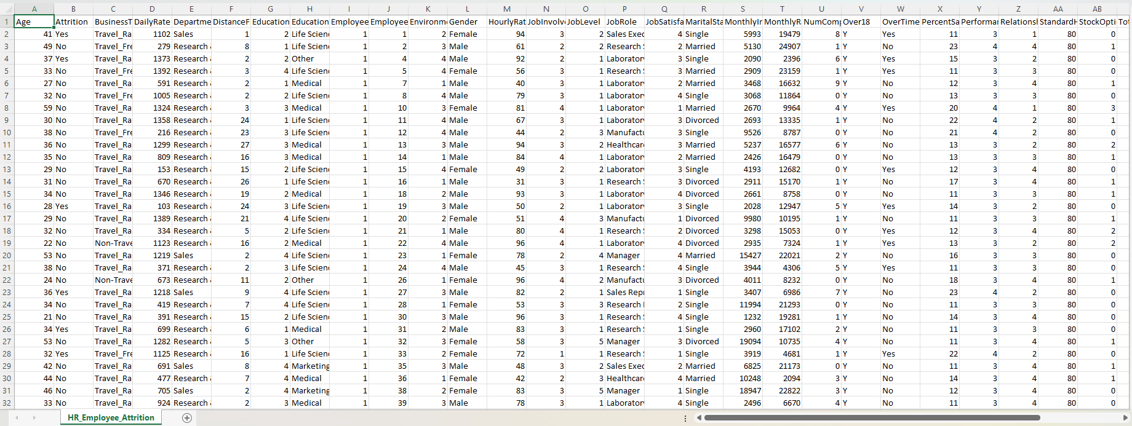
Data Cleaning / ETL
Employee Attrition Dataset - Raw
Notes:
Roxann - Talk about raw data set, and source.

Slide 9
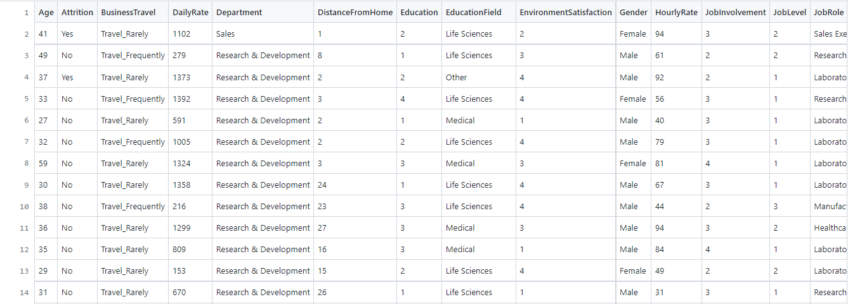
Data Cleaning / ETL
Cleaned Attrition Data
Notes:
Roxann - Cleaned data

Slide 10
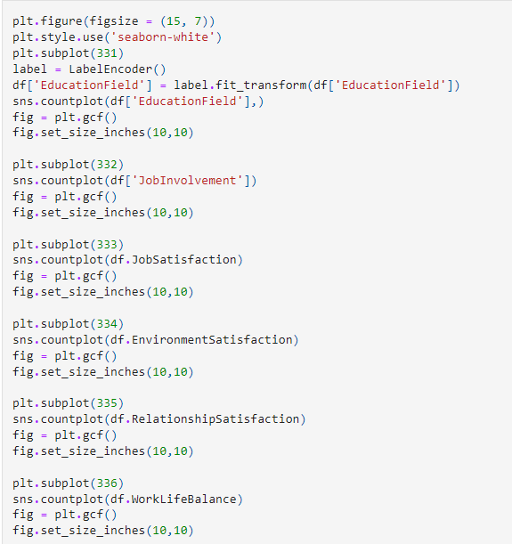
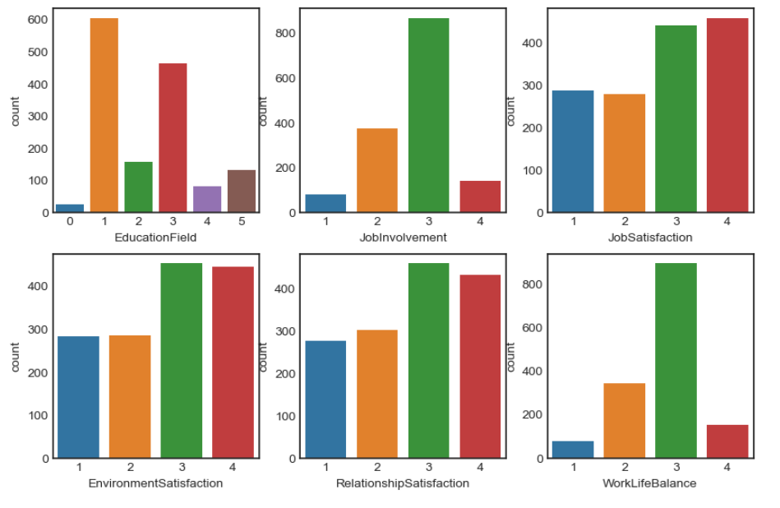
Data Exploration
Data exploration phase: person 1 present
Notes:
Roxann - Describe code and chart

Slide 11
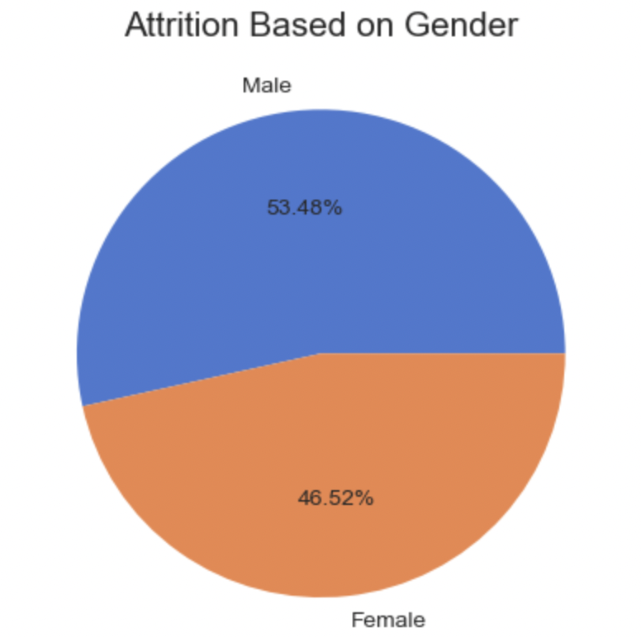
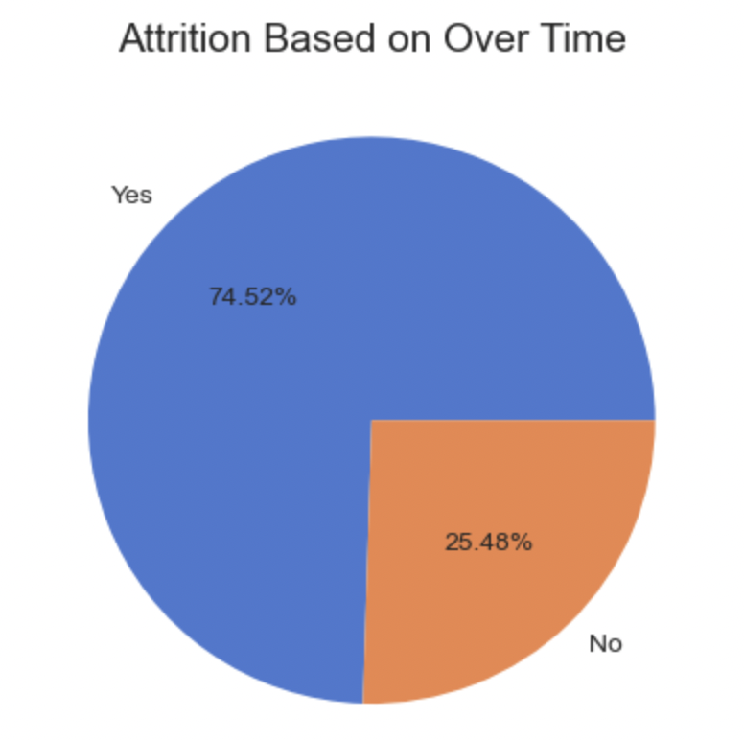
Data Exploration
Notes:
Roxann -

Slide 12
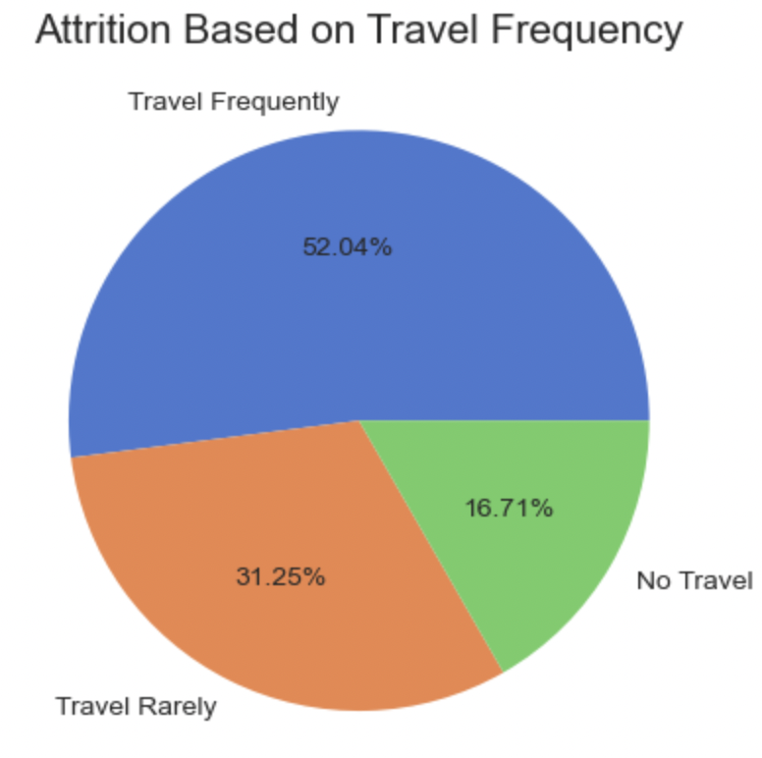
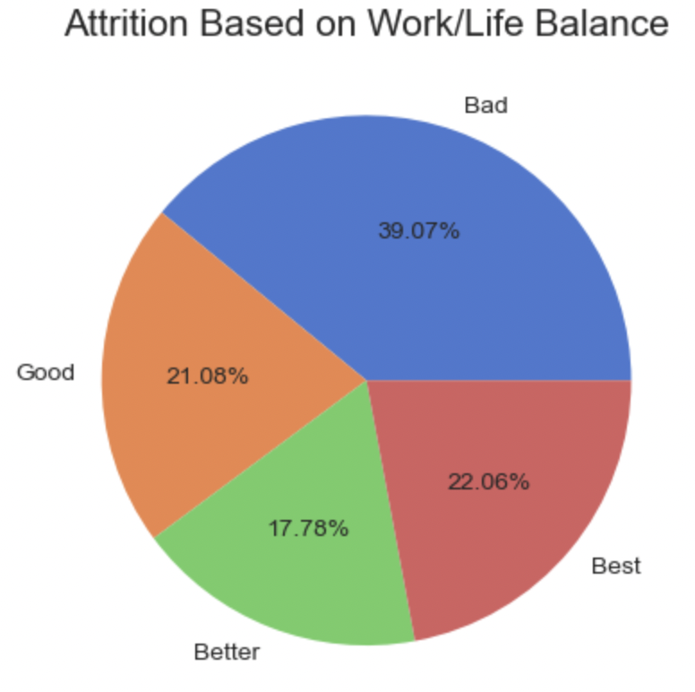
Data Exploration
Notes:
Roxann -

Slide 13
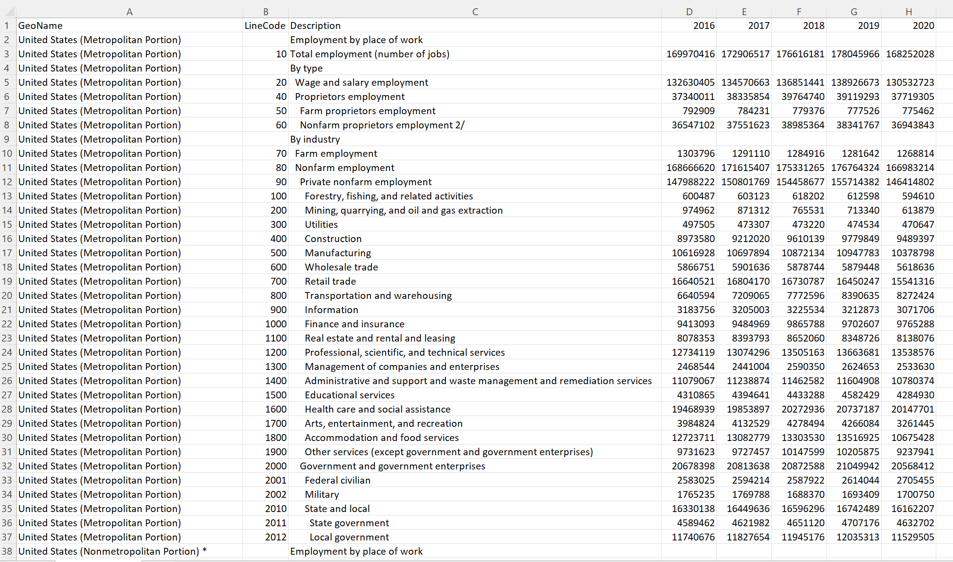
Data Cleaning / ETL
Raw Geographic Data
Notes:
Marc - One of the biggest challenges we faced in week one was gathering usable data that supported the project. Before starting we were optimistic that there would be an abundance of data to choose from that would support our initial thoughts on the subject. We turned out to be wrong and realized that this part of our project would take more time than we had projected. Thankfully we discovered this dataset containing (describe).

Slide 14
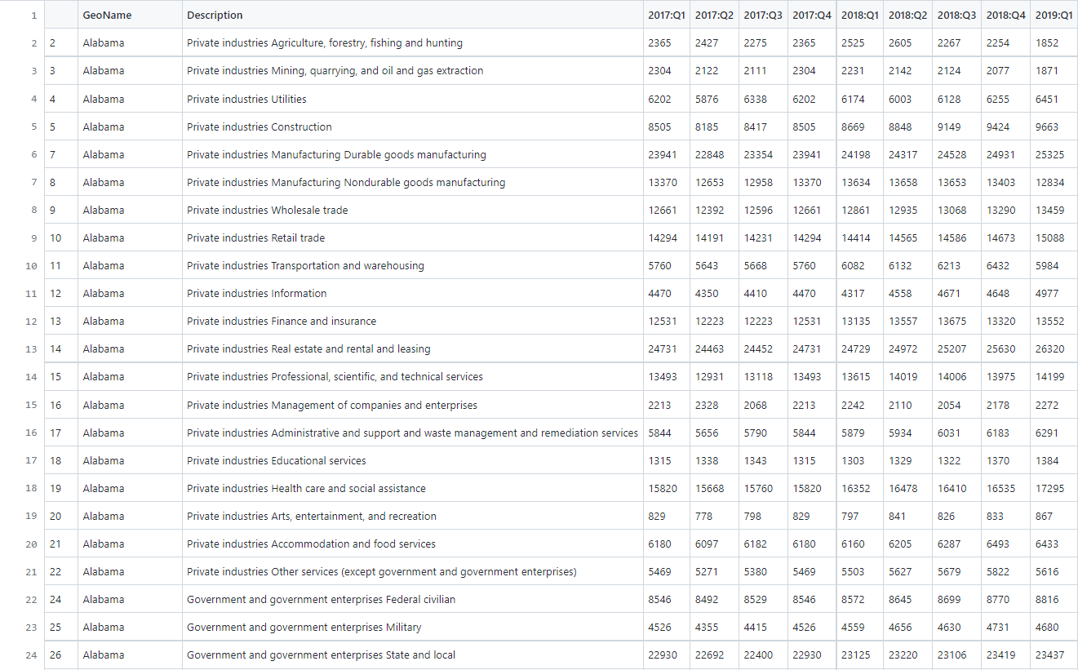
Data Cleaning / ETL
Cleaned Geographic Data
Notes:
Marc -

Slide 15
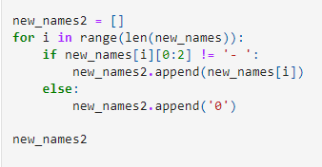
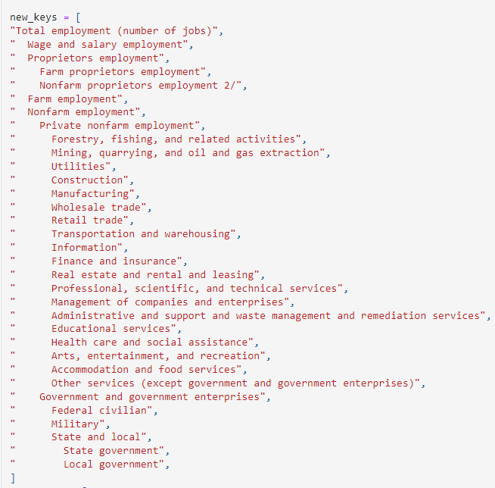
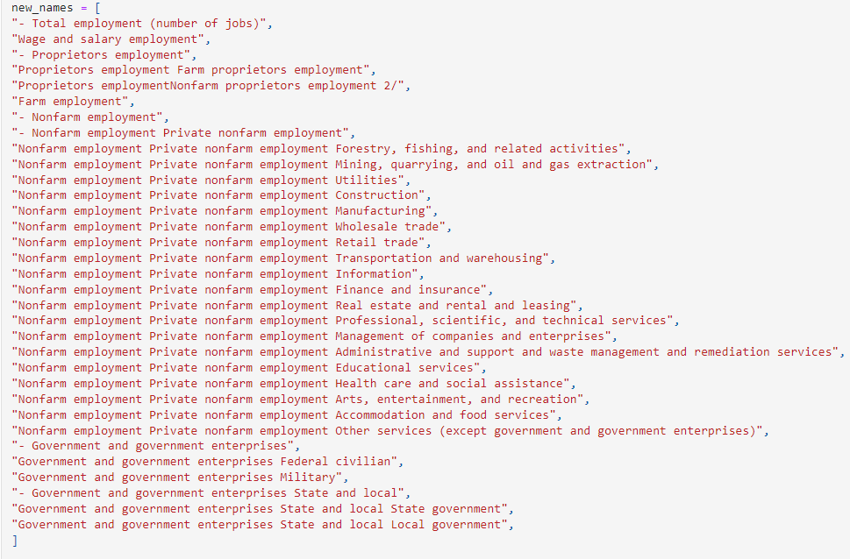
Data Cleaning / ETL
Notes:
Marc -

Slide 16
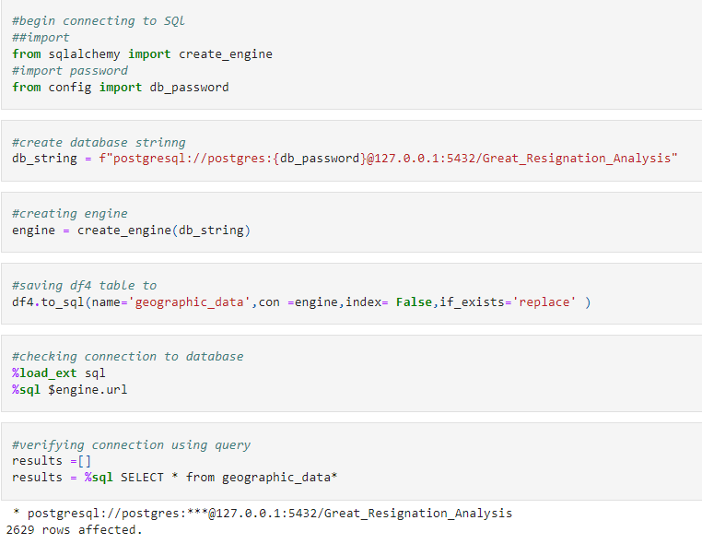
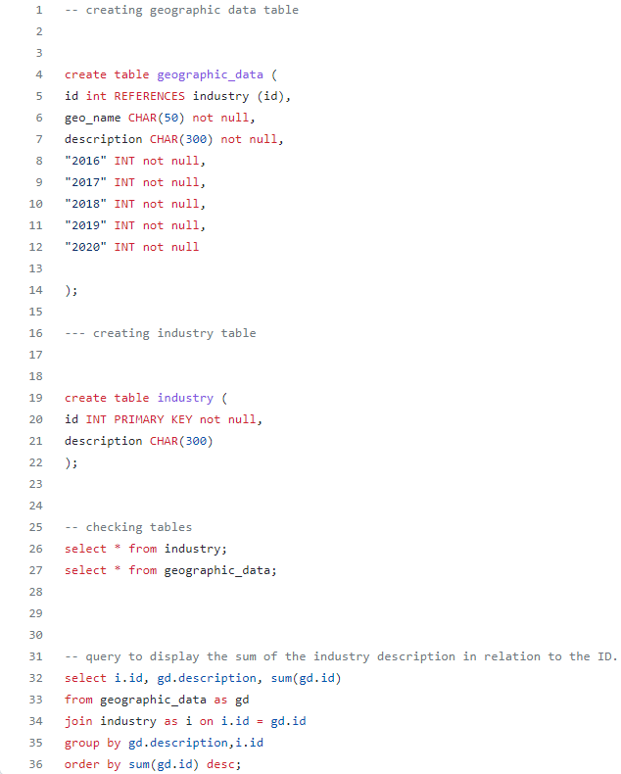
Database / SQL
Notes:
Marc -

Slide 17
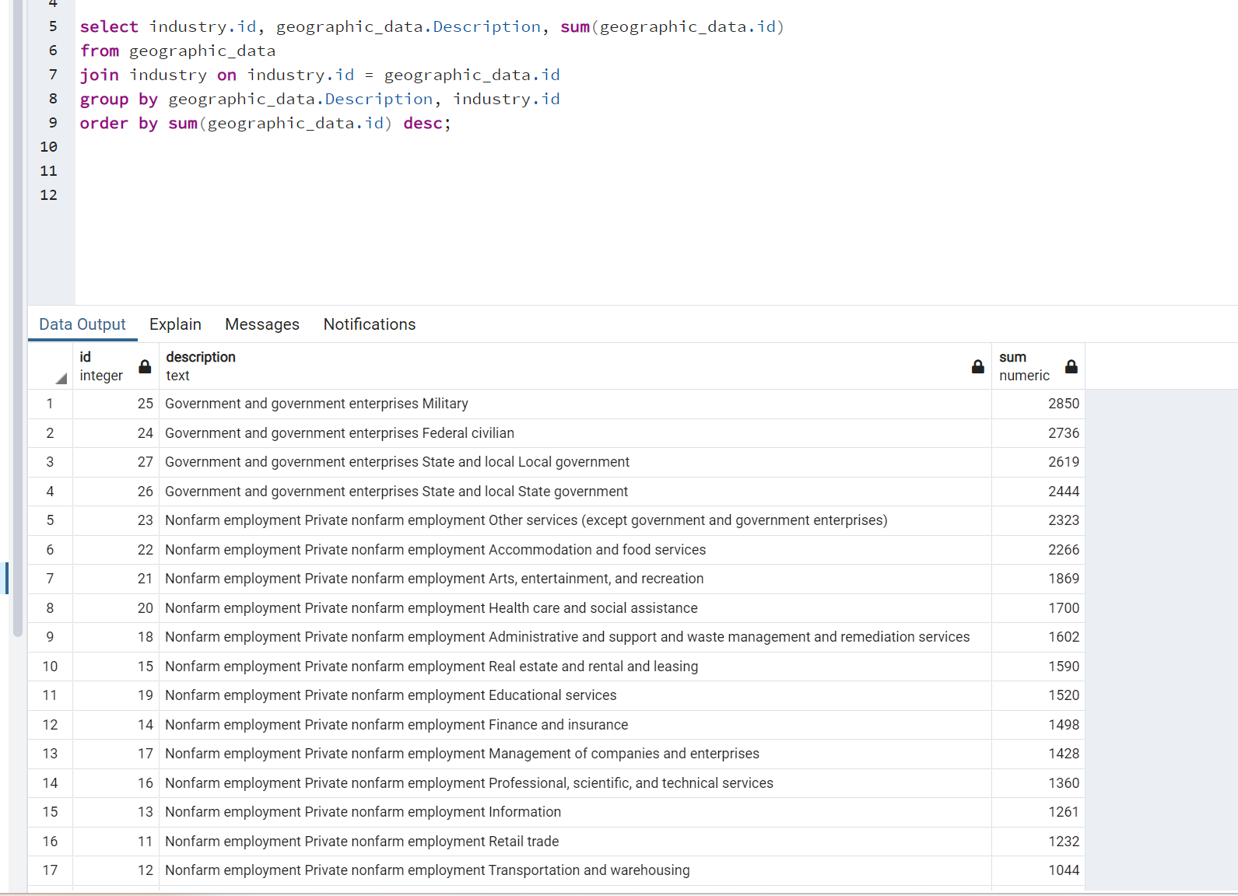
Database / SQL
Notes:
Marc -

Slide 18
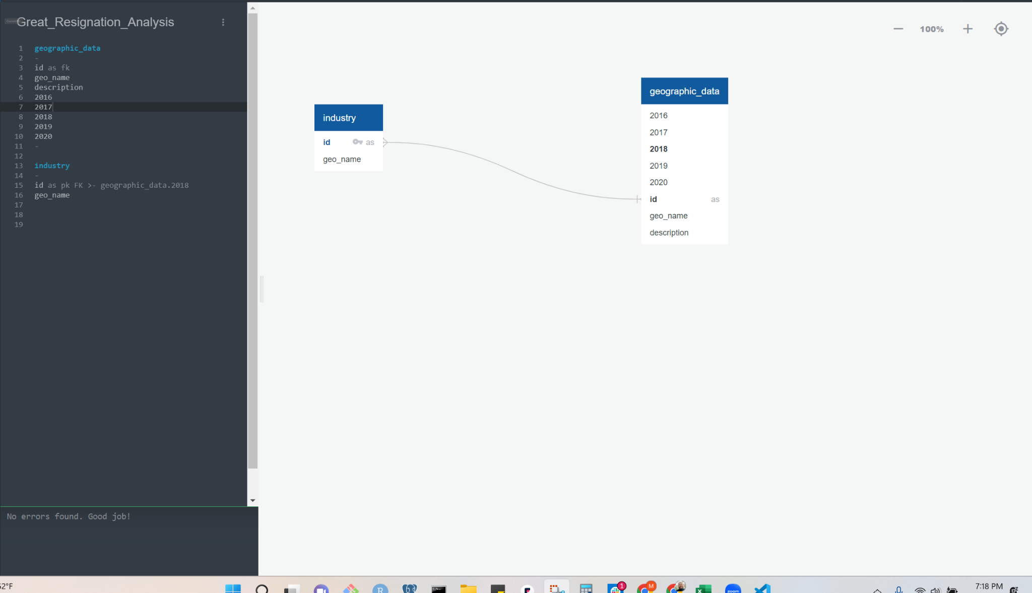
Database / SQL
ERD
Notes:
Marc -

Slide 19
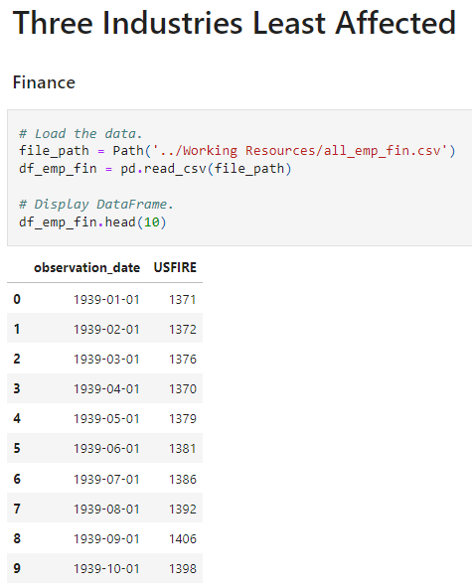
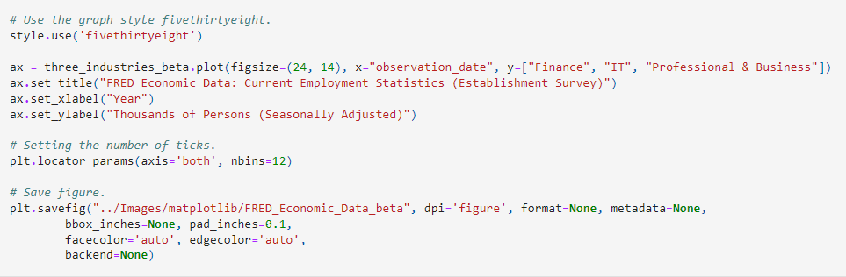
Data Cleaning / Visualization
Notes:
Gus - Finance, It, and Professional and Business categories

Slide 20
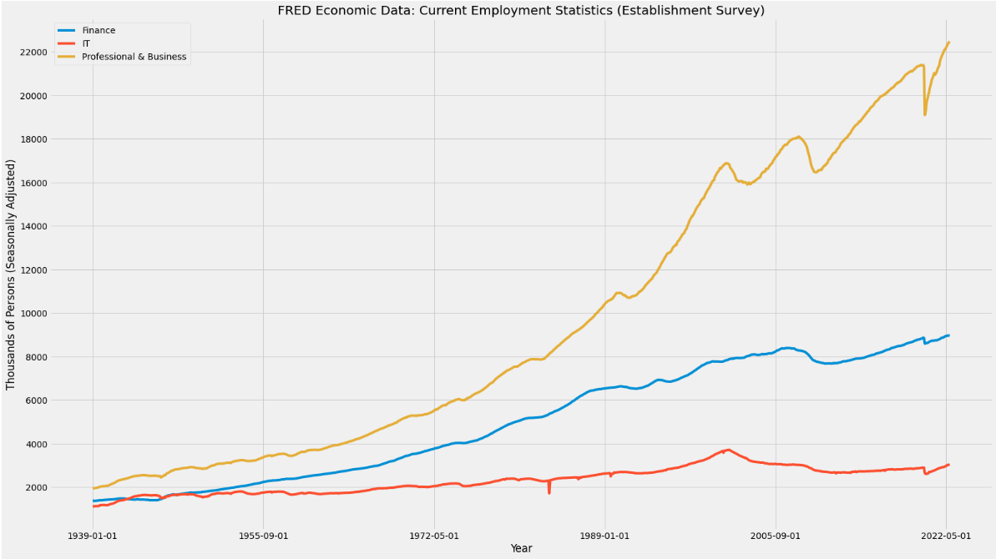
Notes:
Gus -

Slide 21
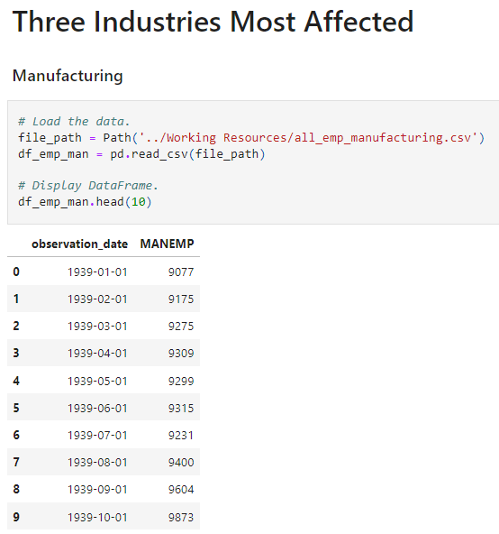
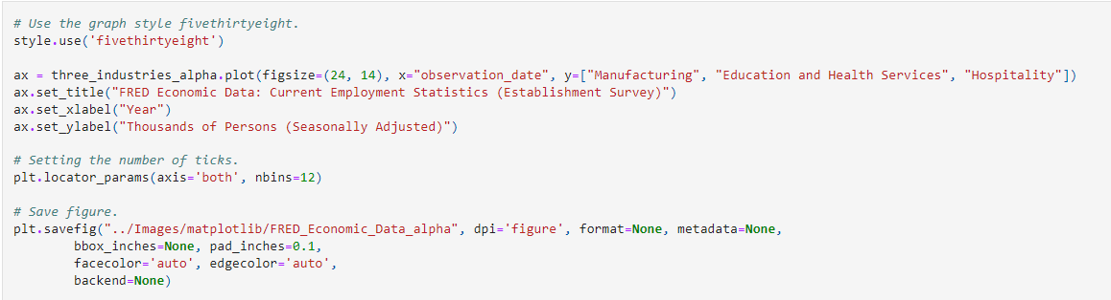
Data Cleaning / Visualization
Notes:
Gus - Manufacturing, Education and Health, and Hospitality.

Slide 22
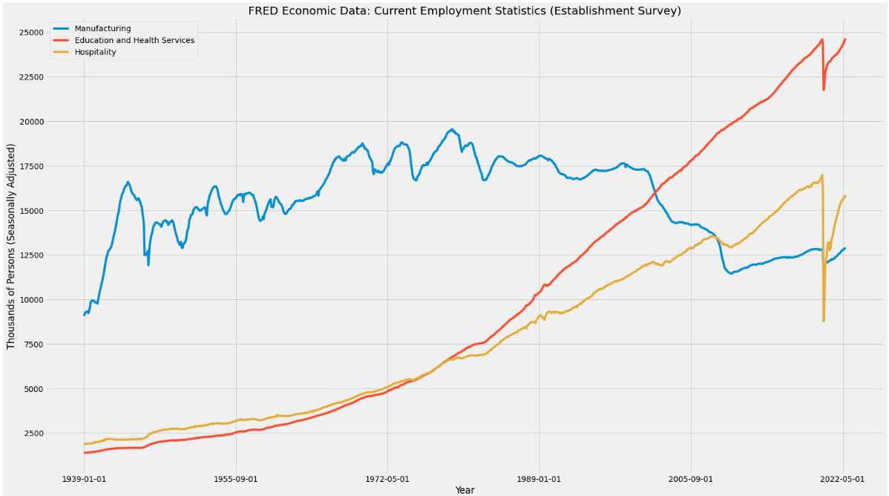
Notes:
Gus -

Slide 23
Machine Learning
Notes:
Gus -

Slide 24
Machine Learning
Notes:
Gus -

Slide 25
Machine Learning
Notes:
Gus -

Slide 26
Results of Analysis

Slide 27
Results of Analysis

Slide 28
Tableau

Slide 29
Tableau

Slide 30
Recommendations for future

Slide 31
What would we do differently

Slide 32
Conclusion

